Slide 1
Analysis of internal temperature control system in a C shaped channel using P, PI,
PID controllers
Md Farhan 1710035
Md Tusher Mahmud 1710036
Md Shahed Hossain Sohan 1710043
Mehedi Hasan 1710060
Fayes Us Shoaib 1710070
Ibrahim Hossain 1710077
Department of Mechanical Engineering
Bangladesh University of Engineering and Technology Dhaka-1000, Bangladesh

Slide 2
Overview
Introduction
Literature Review
Objectives
Physical Model
Mathematical Formulation
Numerical Procedure
Results and Discussion
Conclusion

Slide 3
Literature Review
Author | Shape | Flow condition | Controller
Armaghani et al. [1] | C-shaped | Channel | Absent
Rashad et. al. [2] | U-shaped | Cavity | Absent
Mansour et al. [3] | C-shaped | Cavity | Absent
Yeasmin et al. [4] | L-shaped | Cavity | Absent
Saha et al. [5] | T-shaped | Channel | P, PI, PID
Damasceno and Filho [6] | Shell and Tube | Vented Cavity | PI
Reddy and Balaji [7] | Shell and Tube | Vented Cavity | GA-PID
Prakash et al. [8] | Square | Vented Cavity | P, PI, PID
Shuvo et al. [9] | Square | Vented Cavity | P, PI, PID
Present Study | C-Shaped | Channel | P, PI, PID

Slide 4
Objectives
To develop the mathematical model for the problem on investigating conjugate MHD mixed convection in a triangular cavity with a heat conducting rotating cylinder
To solve and validate the mathematical model numerically using Galerkin finite element method​
To study the conjugate effect of Richardson, Grashof and Reynolds numbers on heat transfer rate
To investigate the effect of varying Hartmann numbers along with the direction of rotation of the cylinder on thermal performance

Slide 5
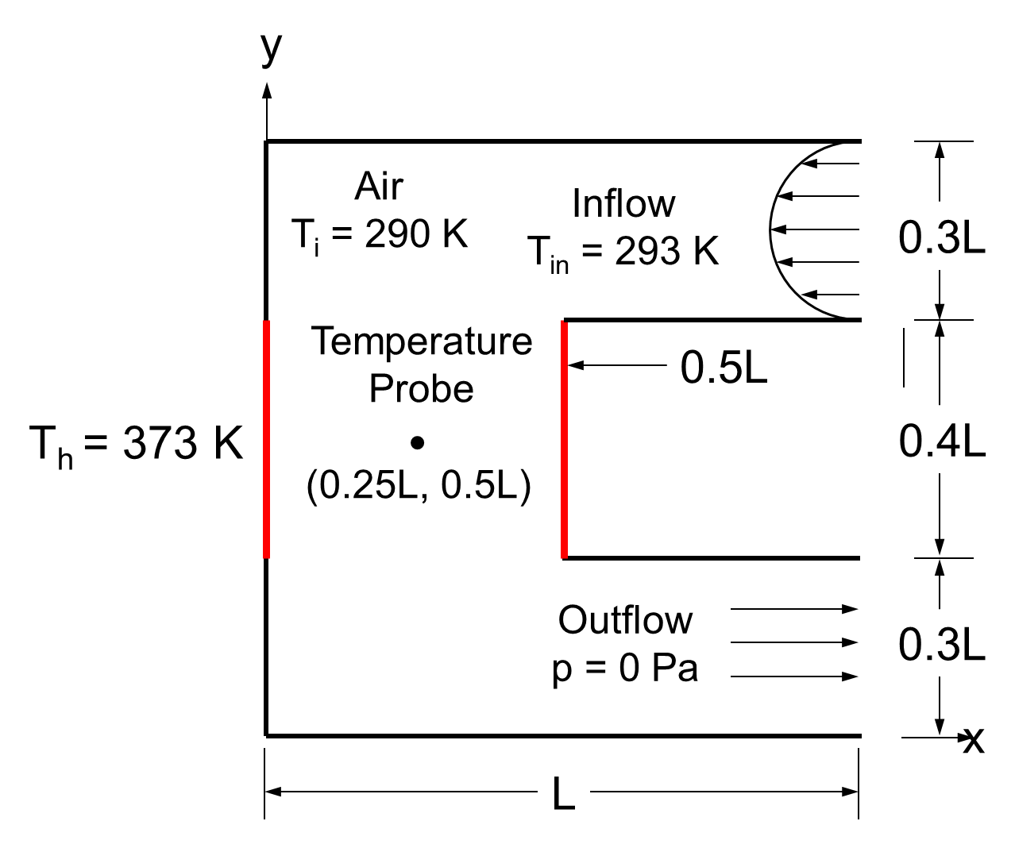
Physical Model
Schematic diagram of the physical model consists of C-shaped enclosure with isothermal heat source (color line)

Slide 6
Boundary Conditions
Boundary | Thermal condition | Velocity Condition
Inlet
Outlet
Heat Source
Cylindrical wall

Slide 7
Mathematical Formulation
Continuity equation:
X-Momentum equation:
Y-Momentum equation:
Energy equation for flow domain:

Slide 8
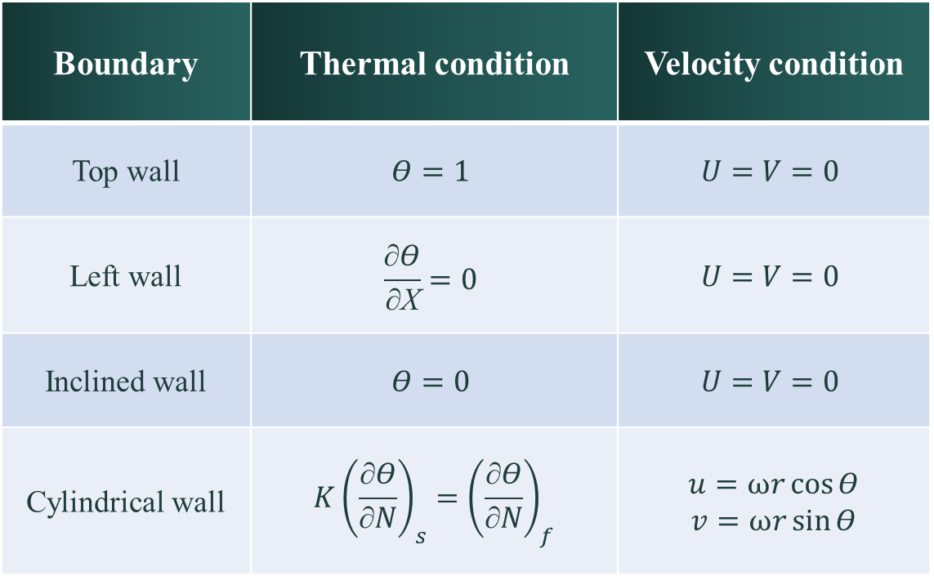
Boundary Conditions
Boundary | Thermal condition | Velocity condition
Top wall | $$Θ=1$$ | $$U=V=0$$
Left wall | $$\frac{\text{∂}Θ}{\text{∂}\text{X}}=0$$ | $$U=V=0$$
Inclined wall | $$Θ=0$$ | $$U=V=0$$
Cylindrical wall | $$K{\left(\frac{\text{∂}Θ}{\text{∂}N}\right)}_{s}={\left(\frac{\text{∂}Θ}{\text{∂}N}\right)}_{f}$$ | $$u=ωr\cos{Θ}$$ $$v=ωr\sin{Θ}$$
Table 1. Boundary Conditions

Slide 9
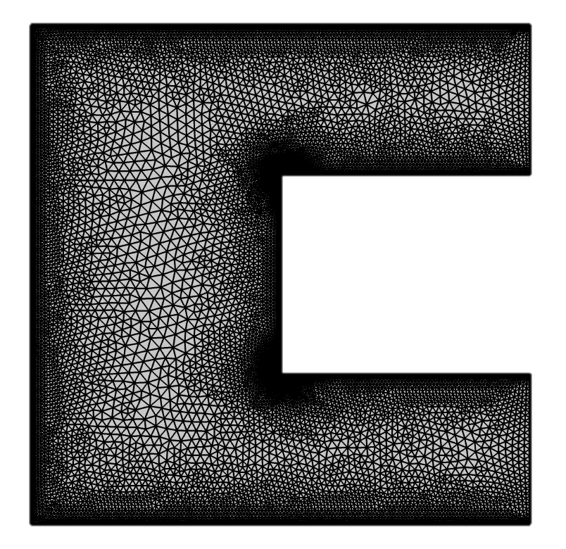
Numerical Procedure
Galerkin Finite Element Method based on Weighted Residual Method has been deployed to conduct the numerical simulation by the commercial software COMSOL Multiphysics 6.0 licensed to Sumon Saha
Optimum mesh information:
Mesh Property | Statistics
Number of Nodes | 11784
Number of Elements | 21370
Triangles | 19954
Quads | 1416
Edge elements | 780
Vertex elements | 10
Average element quality | 0.8051
Element area ratio | 0.001005
Meshed geometry of the C-shaped channel

Slide 10
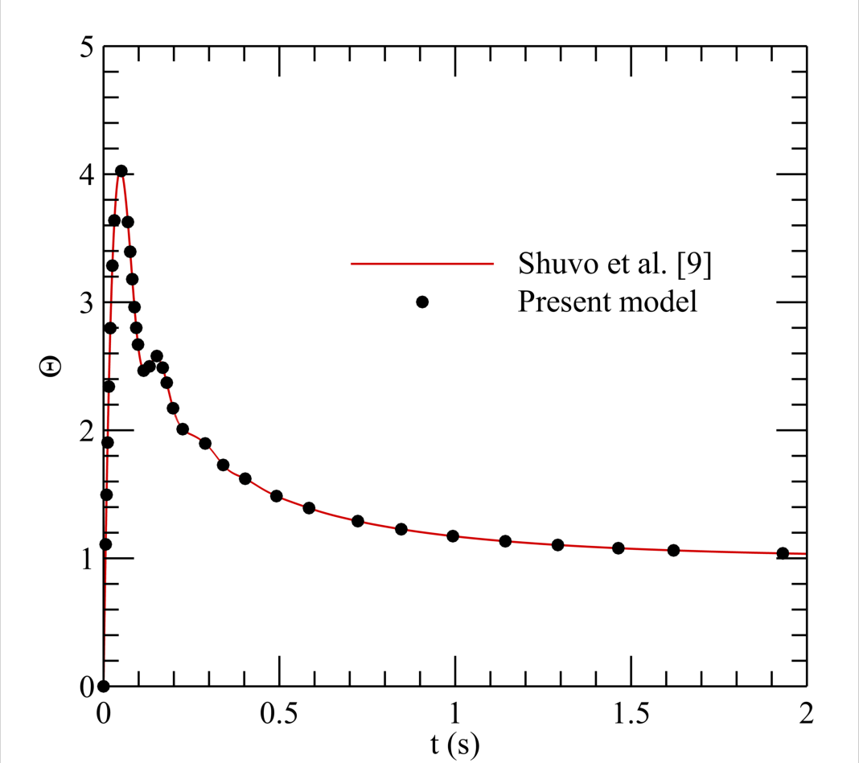
Validation
Validation of the present model in terms of Θ at Kp = 0.01 ms⁻¹K⁻¹, Ki = 0.1 ms⁻²K⁻¹ and Kd = 0.00001 mK⁻¹ with the results of Shuvo et al. [9]

Slide 11
Results and Discussion
P Controller
Advantages
Easy to implement
Decreases rise time and sensitivity
Gain increase reduces steady state error
Transfer function
Disadvantages
Overshoot increases
Cannot eliminate steady state error

Slide 12
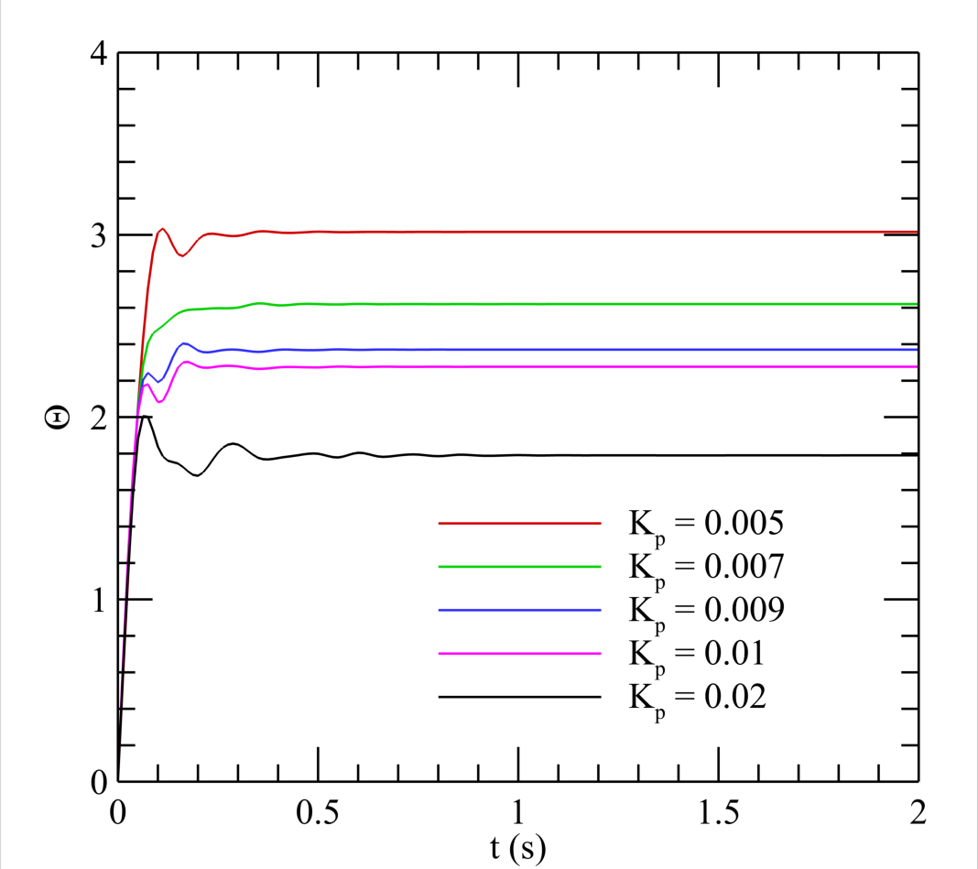
Results and Discussion
P Controller
At higher gain, Kp
Overshoot
Steady state error
Stability
Rise time
Settling time:
0.8s for K_{p}= 0.02
0.4s for K_{p} = 0.005, 0.007, 0.009, 0.01 ms⁻¹ K⁻¹
Figure: Variation of response for P controller in terms of Θ at different level of gain.

Slide 13
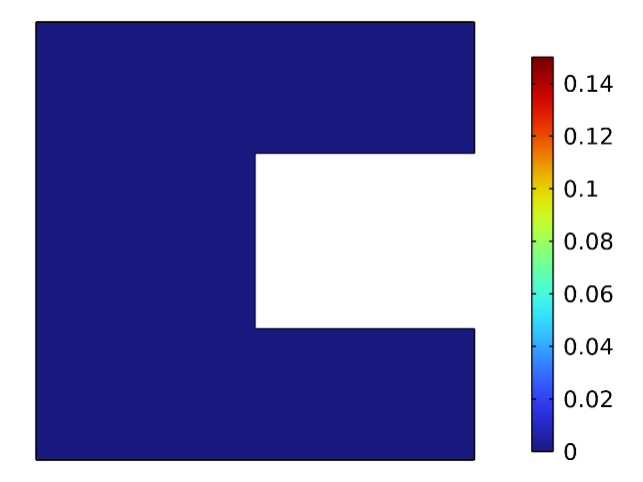
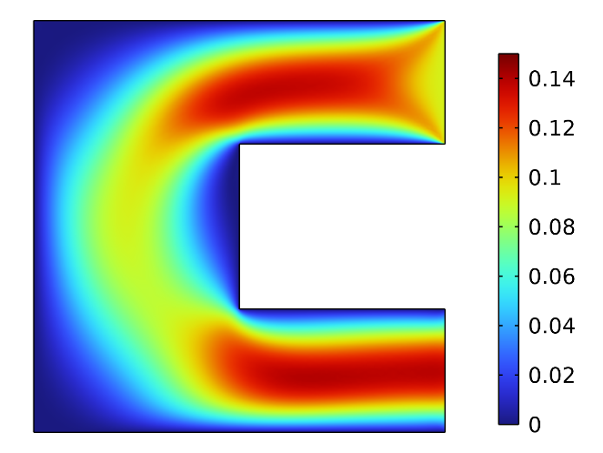
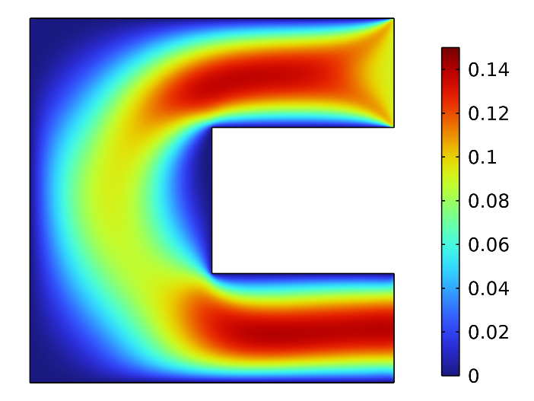
Results and Discussion
P Controller
Velocity Distribution
(a) t = 0 s
(b) t = 0.2 s
(c) t = 2 s
Figure: Variation in flow velocity through the channel in terms of surface plot for K_{p} = 0.007 ms⁻¹ K⁻¹, at (a) t = 0 s, (b) t = 0.02 s, and (c) t = 2 s.
Initially No flow(t =0 s)
Outlet velocity is higher in magnitude

Slide 14
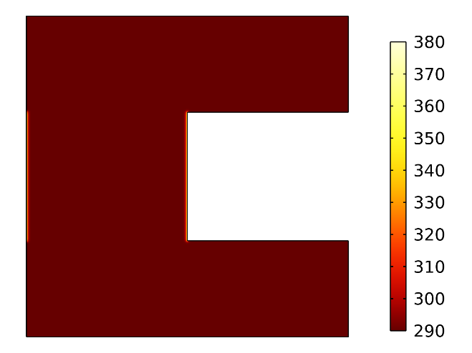
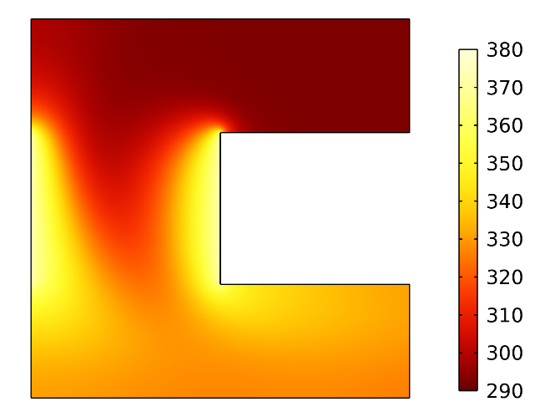
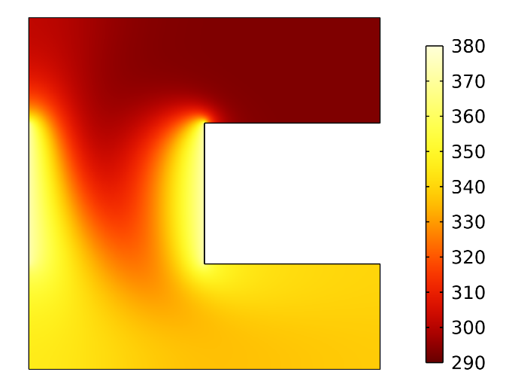
Results and Discussion
P Controller
Thermal field:
(a) t = 0 s
(b) t = 0.2 s
(c) t = 2 s
Figure: Variation of thermal flow field in terms of surface plot inside the cavity at (a) t = 0 s (b) t = 0.2 s (c) t =2 s using P controller at Kp = 0.007 ms⁻¹K⁻¹
The forced flow continues until the temperature at the desired point reaches the desired setpoint temperature.

Slide 15
Results and Discussion
PI Controller
Advantages
Eliminate steady-state error
Decreases rise time and sensitivity
Offset both P and I controller problems
Transfer function
Disadvantages
Overshoot increases
Oscillating behavior is present
Sluggish response compared to P controller

Slide 16
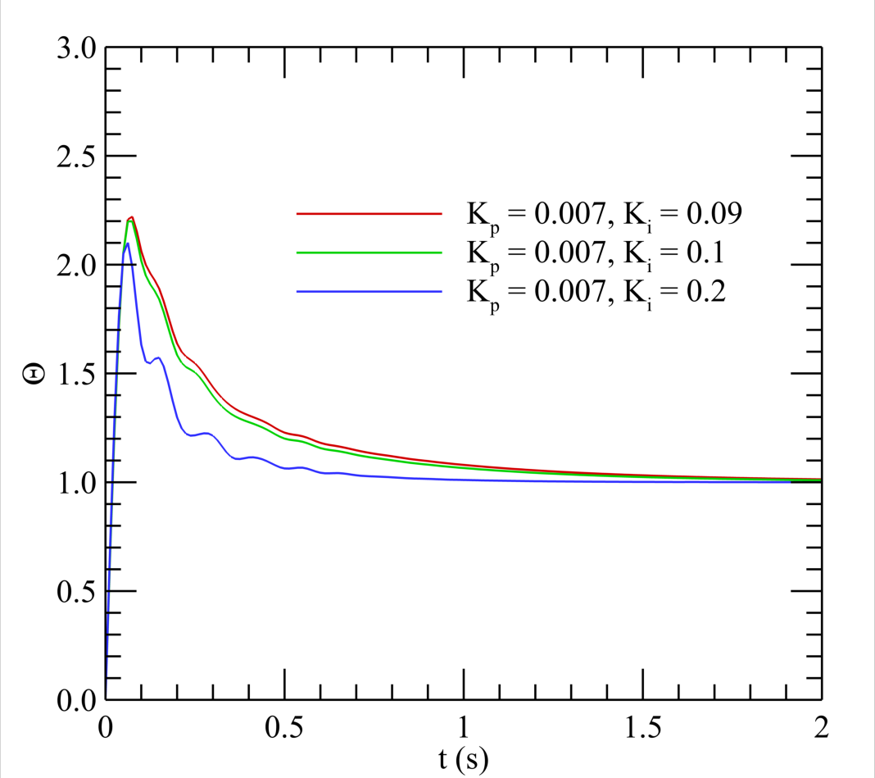
Results and Discussion
PI Controller
At a higher gain, Ki
Overshoot
Stability
Settling time
Settling time:
0.7s for K_{i} = 0.2
1.7s for K_{i} = 0.09, 0.1
Overshoot:
110% for K_{i} = 0.2
120% for K_{i} = 0.1
125% for K_{i} = 0.0.09
Figure: Variation of response for PI controller in terms of Θ at different level of gains.

Slide 17

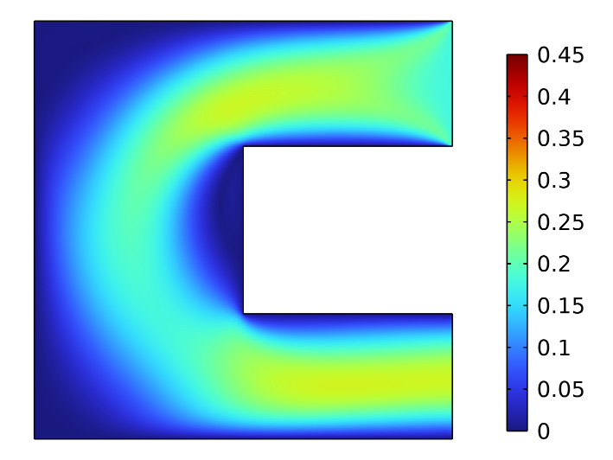
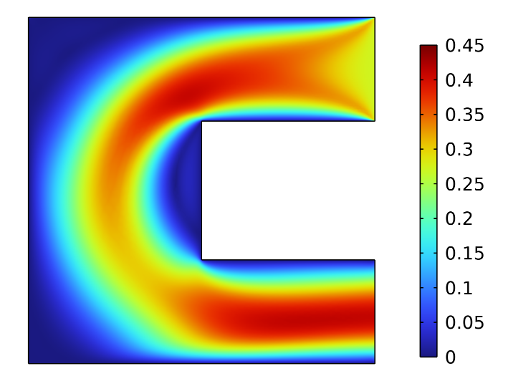
Results and Discussion
PI Controller
Flow field:
(a) t = 0 s
(b) t = 0.2 s
(c) t = 2 s
Figure: Variation in flow velocity through the channel in terms of surface plot for K_{p} = 0.007 ms⁻¹ K⁻¹, K_{i} = 0.2 ms⁻²K⁻¹ at (a) t = 0 s, (b) t = 0.02 s, and (c) t = 2 s.

Slide 18
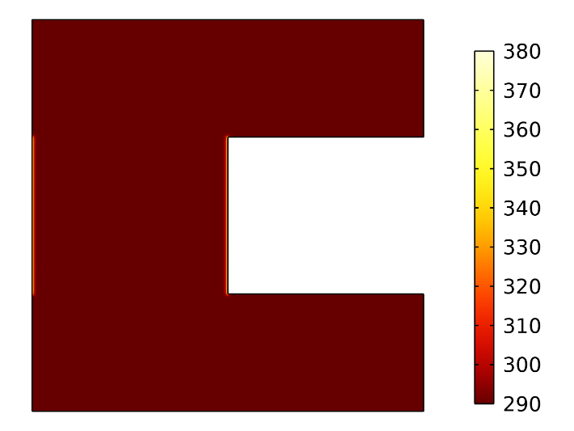
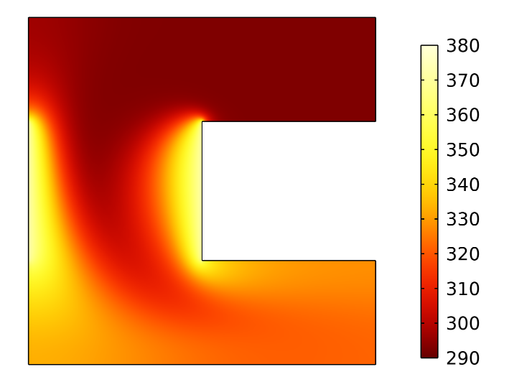
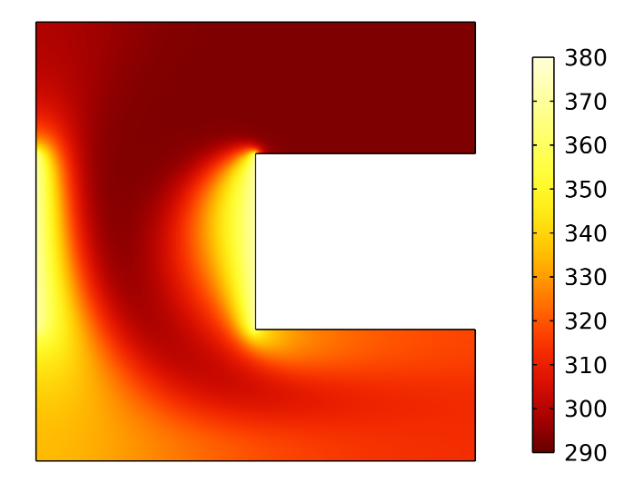
Results and Discussion
PI Controller
Thermal field:
(a) t = 0 s
(b) t = 0.2 s
(c) t = 2 s
Figure: Variation in fluid temperature through the channel in terms of surface plot for K_{p} = 0.007 ms⁻¹ K⁻¹, K_{i} = 0.2 ms⁻²K⁻¹ , at (a) t = 0 s, (b) t = 0.02 s, and (c) t = 2 s.

Slide 19
Results and Discussion
PID Controller
Proportional feedback gain reduces the steady state error.
The integral portion makes it zero but system becomes less stable.
Derivative controller improves the stability of the system without affecting the steady state error.
Transfer Function:
The PID controller takes the advantage of all 3 controllers analyzed here.

Slide 20
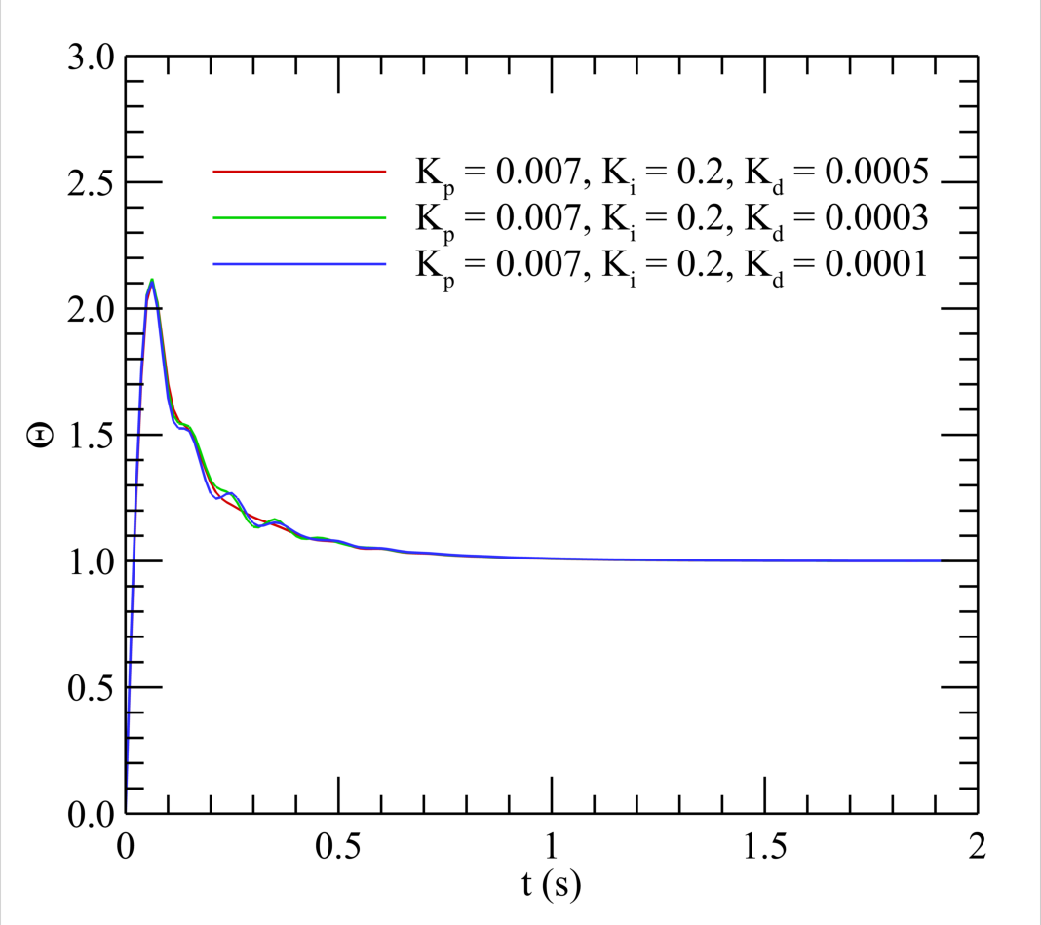
Results and Discussion
PID Controller
%Overshoot = 110%
Settling time, T_{s} = 0.96s
Figure: System Response of PID controller with Θ for K_{d} = 0.0001, 0.0003, 0.0005 mK⁻¹ at K_{p} = 0. 007 ms⁻¹ K⁻¹, K_{i} = 0.2 ms⁻²K⁻¹.

Slide 21
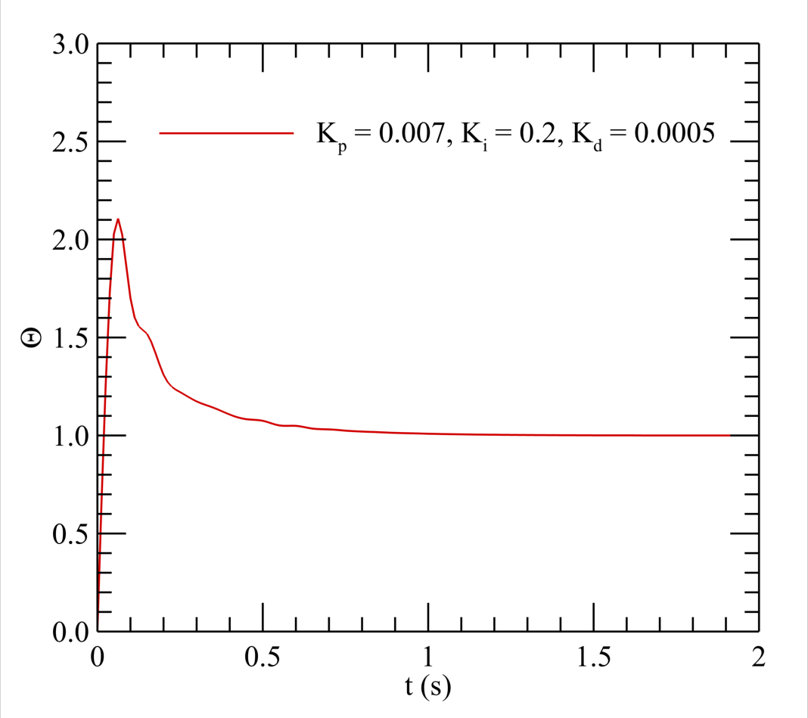
Results and Discussion
PID Controller
At K_{d} = 0.0005 mK⁻¹
Less jerking
Smoother response
Lower settling time (0.85s)
Figure: System Response of the PID controller with Θ for K_{d} = 0.0005 mK⁻¹ at K_{p} = 0. 007 ms⁻¹ K⁻¹, K_{i} = 0.2 ms⁻²K⁻¹.

Slide 22
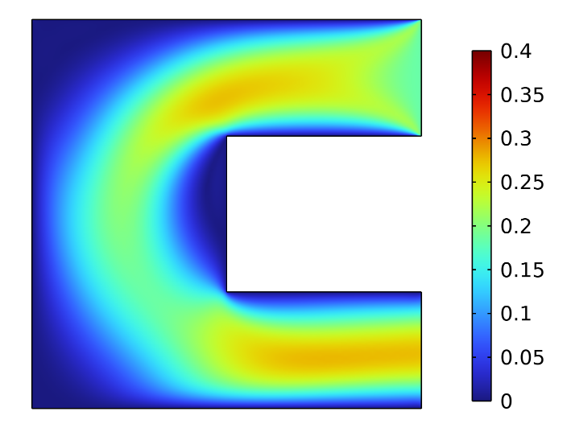
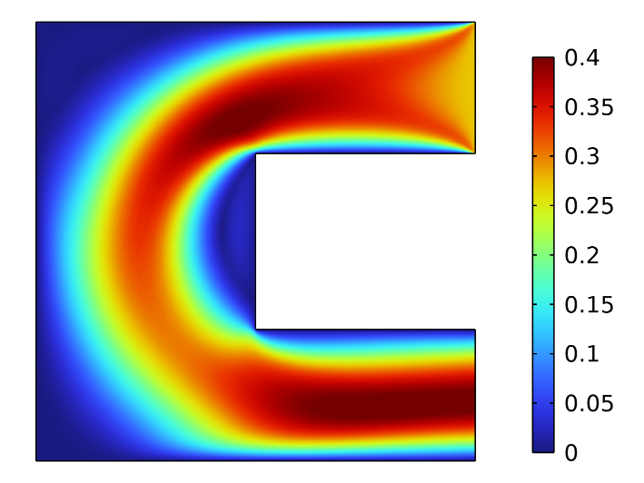
Results and Discussion
PID Controller
Flow field:
(a) t = 0 s
(b) t = 0.2 s
(c) t = 2 s
Figure: Variation in flow velocity through the channel in terms of surface plot for K_{p} = 0.007 ms⁻¹ K⁻¹, K_{i} = 0.2 ms⁻²K⁻¹, and K_{d} = 0.0005 mK⁻¹ at (a) t = 0 s, (b) t = 0.02 s, and (c) t = 2 s.

Slide 23
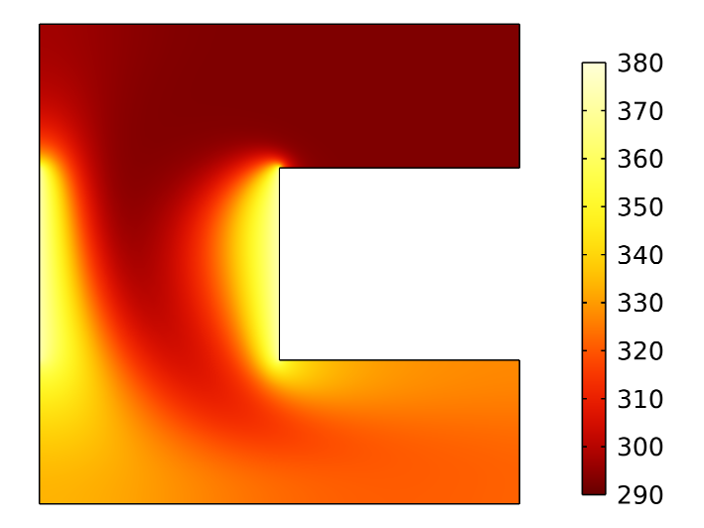

Results and Discussion
PI Controller
Thermal field:
(a) t = 0 s
(b) t = 0.2 s
(c) t = 2 s
Figure: Variation in fluid temperature through the channel in terms of surface plot for K_{p} = 0.007 ms⁻¹ K⁻¹, K_{i} = 0.2 ms⁻²K⁻¹, and K_{d} = 0.0005 mK⁻¹ at (a) t = 0 s, (b) t = 0.02 s, and (c) t = 2 s.

Slide 24
Conclusion
P controller’s steady state performance is worse at lower gain.
At higher value of gain system becomes more unstable and show oscillations.
Maximum overshoot increases at higher value of gain
PI controllers are slower than P controllers and do eliminate steady-state error, although they are faster with higher Ki values. Regardless of Ki values, the steady state is always errorless. And, as a result of the combination, performance may vary depending on the value.
PID controller stabilize the system, make it smoother and reduces the steady state error to zero.

Slide 25
Acknowledgement
We would express our profound gratitude to the Dr. Sumon Saha, Professor, Department of Mechanical Engineering, Bangladesh University of Engineering and Technology (BUET) for providing continuous support throughout our research works.​​

Slide 26
References

